Slide 1
Visualizing your data effectively
Kim Unger – Fall 2017

Slide 2
About me
Senior Analytics Consultant, DataBrains
Former SSEF, ISEF, STS Finalist
Science Fair Judge (regional, SSEF, ISEF)
Data Visualization is my day-to-day job
kunger@databrains.com
@WizardOfViz

Slide 3
agenda
Overview – four questions
Choosing the right chart/graph
Other visualizations
Visual Best Practice
Tableau – Visualization software
FREE

Slide 4
Four questions
1. What data is important to show?
2. What do I want to emphasize in the data?
3. What options do I have for displaying this data?
4. Which option is most effective in communicating the data?

Slide 5
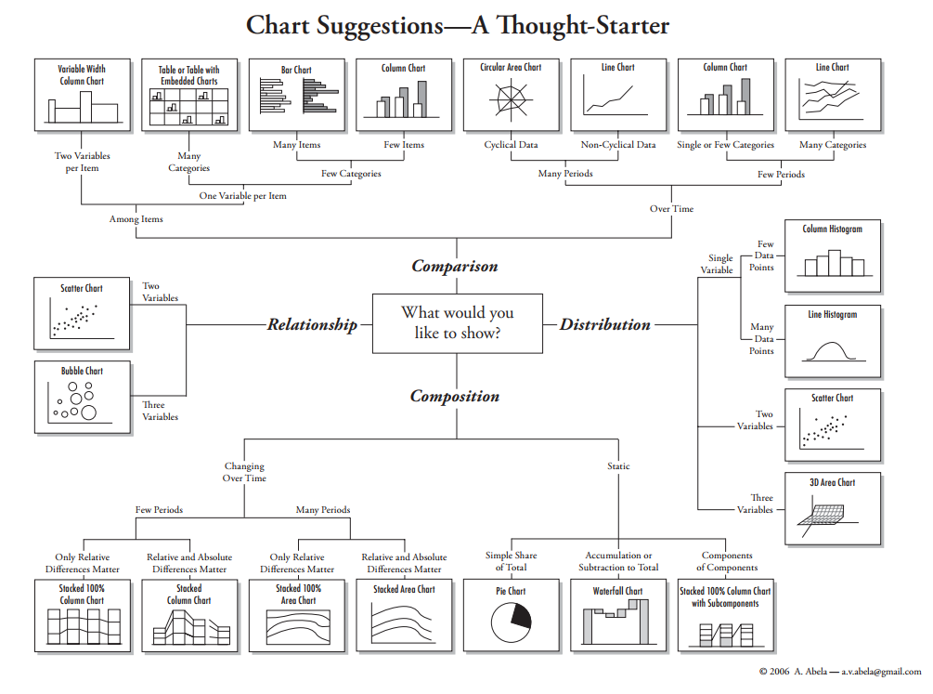

Slide 6
What do you want to show with your data?
Time Series
Ranking
Part-To-Whole
Deviation
Distribution
Correlation
Comparison

Slide 7
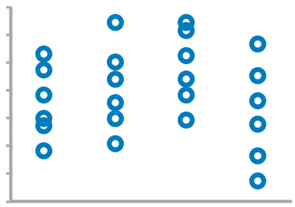
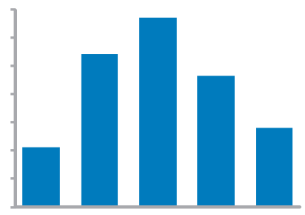
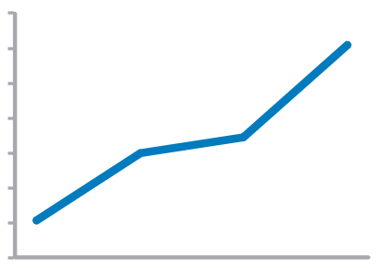
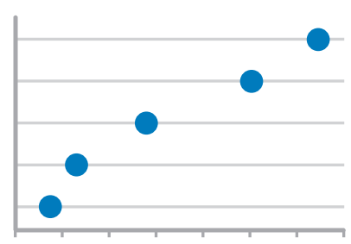
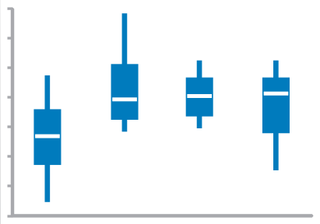
Time series values display how something changed over time
Strip Plot (multiple)
Only when also featuring distributions
Bar Graph (vertical)
To feature individual values and support their comparisons. Quantitative scale must begin at zero.
Line Graph
To feature overall trends and patterns and support their comparisons
Dot Plot (vertical)
When you do not have a value for every interval of time
Box Plot (vertical)

Slide 8
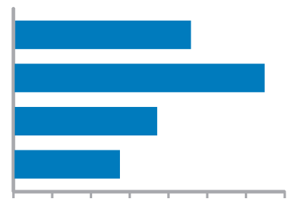
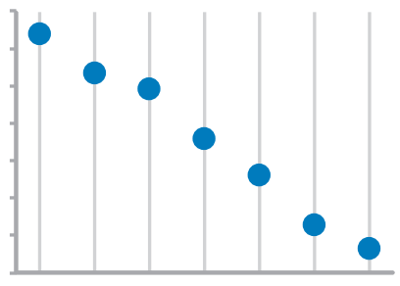
ranking values are ordered by size (descending or ascending)
Bar Graphs
Quantitative scale must begin at zero
Dot Plots

Slide 9
Part-to-whole values represent parts (ratios) of a whole
Bar Graphs
Quantitative scale must begin at zero

Slide 10
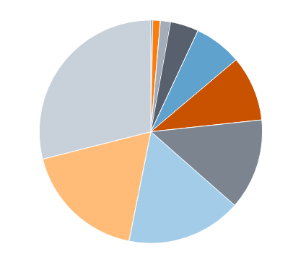
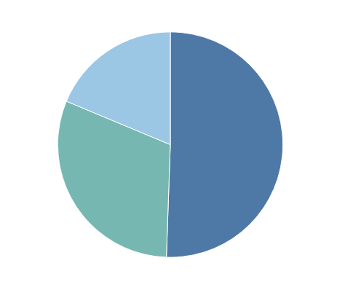
What about pie charts?
Commonly used to show parts of a whole
However…
Hard to judge relative size of pie slices – better at differentiating length
Take up a lot of space to present little information
Require labels and good color contrast to even be usable (often difficult)
Best use is when one overwhelmingly larger value than the rest – no need to focus on actual values

Slide 11
deviation difference between two sets of values
Bar Graphs
Quantitative scale must being at zero
Line Graph
Only when also featuring time series or single distribution

Slide 12
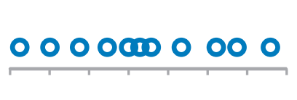
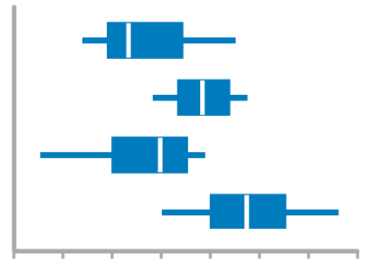
Distribution count of values per interval along quantitative scale
Strip Plot (single)
When you want to see each value
Bar Graphs
Quantitative Scale, must begin at zero
Strip Plot (multiple)
When comparing multiple distributions AND you want to see each value
Line Graph
To feature overall shape of distribution
Box Plots
When Comparing Multiple Distributions

Slide 13
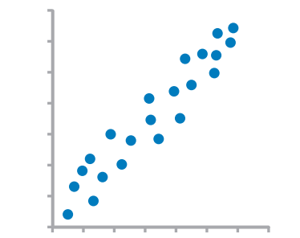
Correlation Comparison of two paired sets of values to determine if there is a relationship between them
Scatter Plot

Slide 14
Normal comparison simple comparison of values for a set of ordered items
Bar Graphs
Quantitative scale must begin at zero
Dot Plots

Slide 15
Other visualizations a picture is worth a thousand words
Schematics
Illustrations
Flow Charts
Explain how experiment was conducted or design concepts for engineering project
Raw data or statistical summaries in well-organized manner.
Convey important details.
Tables
Photographs
Great to show experimental setup, or examples of actual results

Slide 16
Adhere to data presentation standards in your field
Judged by those often familiar with research field
Expected presentations of data in that field
Review scientific articles – how is data presented?
Are there graphs?
What kind?
What statistics are used?
Review schematics – are there specific icons?
Does the journal have a style guide?

Slide 17
Visual best practices
Emphasize
most important data
Orient
graphs for legibility
Organize
graph/table
Avoid
overloading graphs
Limit
# of colors and shapes
Inform
through important text

Slide 18
Data analysis vs data visualization
Traditionally enter data into spreadsheet (Excel)
Satisfactory, but strengths are in data analysis – not visualization
Time consuming to create graph variations
Alternative: Use data visualization software
FREE to students and teachers with .edu email
https://www.tableau.com/academic/teaching

