Slide 1
Scientific Review Committee (SRC)
Evaluation of student research for compliance with rules, applicable laws, and regulations.
The SRC reviews projects with vertebrates and PHBA prior to experimentation
…and all projects before the Regional Fair.
The SRC will not review projects that are not approved by the student’s teacher.

Slide 2
Projects are examined for
Literature search and attribution
Proper supervision
Accepted and appropriate research techniques
Competed forms, signatures and dates
Humane treatment of animals and search for alternative use
Compliance with rules and laws
Compliance with ISEF ethics

Slide 3
Do I need approval before I start my project? Yes!
Before you start your project you and your adult sponsor must review the ISEF rules and your research plan.
Projects involving human subjects need IRB approval BEFORE you start.
Projects involving animals, potentially hazardous biological agents, hazardous chemicals, agents and activities need SRC approval BEFORE you start.
ALL changes and revisions must be approved BEFORE you make them.

Slide 4
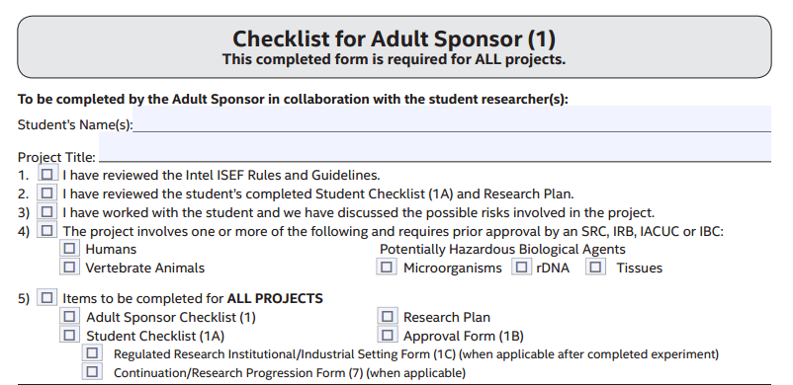
The student’s name must be written clearly and be easy to read.
The project title must be the same on all forms and the research plan.
If any of these are checked your project will need additional review BEFORE you start.
These two are needed only under certain circumstances

Slide 5
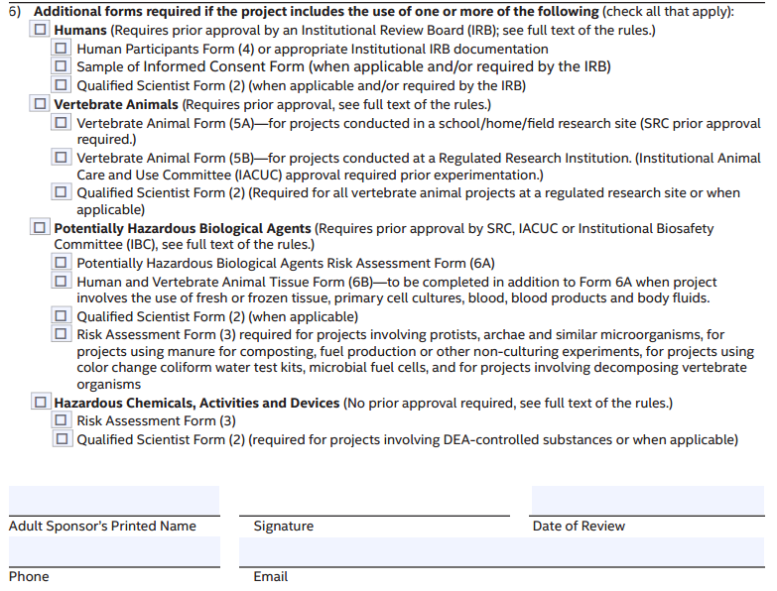
All projects that involve people, samples from people, surveys, or interviews need to be approved by your school IRB BEFORE you start.
There are very specific and strict ISEF rules that MUST be followed for animal projects (vertebrates). These projects need SRC approval BEFORE you start.
There are very specific and strict ISEF rules that MUST be followed for PHBA projects. These projects need SRC approval BEFORE you start.
These include substances and devices that are regulated by law, such prescription drugs, alcohol, tobacco, firearms and explosives. Hazardous activities are those that involve a level of risk above and beyond that encountered in everyday life. No additional approval is needed, but they require direct supervision by a Designated Supervisor
or Qualified Scientist.
The date should be BEFORE you start.

Slide 6
Adult Sponsor
An Adult Sponsor may be a teacher, parent, professor, and/or other professional scientist in whose lab the student is working.
This individual must have a solid background in science and should have close contact with the student during the course of the project.

Slide 7
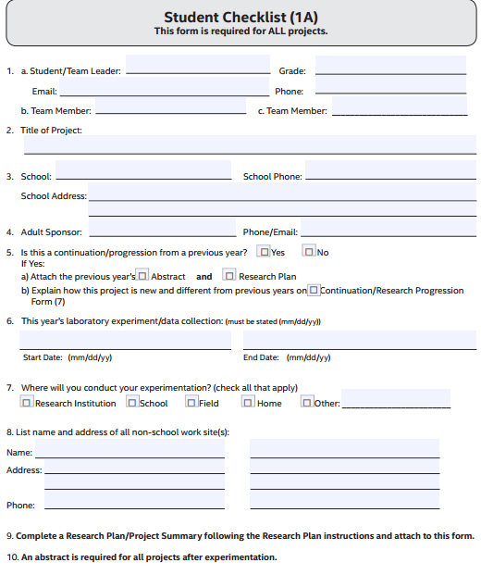
Student’s name clearly written
The best contact email (Student’s or parent’s )
Student’s or parent’s
Fill in ALL information and answer ALL questions.
The project title must be the same on all forms and the research plan.
The same as on Form 1
The first date of the experiment and should match the logbook.
Start date must be AFTER approval dates on Form 1, 1B, 2
Do not answer until you finish.
If work is conducted in any work site other than home, school or field at any time, Form 1C must be completed and displayed at the project booth.
List ALL non-school sites
You may attach additional pages if needed
Don’t forget city and state

Slide 8
Research Plan
ALL research plans should include the following:
Background and rationale –
Why are you doing this project and why is it important?
b. Hypothesis (es), Research Question(s), Engineering goal (s),
or Expected outcome(s)
c. Research methods. Describe in detail how you will conduct this research.
i. Materials: What you need to conduct your research and how much do you need?
ii. Procedures: Detail all procedures including how you will collect data.
This should be in step-by-step order (like a recipe) written clear enough for others to perform the research exactly the same way as you even if you were not present.
iii. Identify any potential risks and describe the safety precautions you will take.
iv. Data Analysis: How are you going to use the data that you collected?
Will you calculate the mean, the frequency, the percentage Will you compare or correlate data points? What statistical tests will you use?
v. CONCLUSIONS- NEW!!!
It is a good idea to put your name, page number, and school name in the header or at the top of each page.

Slide 9
d. Bibliography in APA or MLA format.
i. List at least five (5) major references (e.g. science journal articles,
books, internet sites). If you use more than five sources you need
to include all of them. If you have made use of someone’s
intellectual property (including photographs, published questionnaires,
etc.…) you must acknowledge them.
ii. If you plan to use vertebrate animals, one of the references must be
an animal care reference.
Iii. If you plan to use humans, one of the references must cover the protections for human subjects in research (The Belmont Report or the Code of Federal Regulations 45CFR 46).
iv. If you use photographs that were not taken by you, one of the references must be the source of the pictures.
A copy of all surveys, questionnaires, etc. must be included with paperwork.
Are you using this site for information? Are you using the ISEF site? Make sure you include these references in your bibliography.
Some additional items may need to be included in your research plan if you use :
Human participants
Vertebrate animals
Potentially hazardous biological agents
Hazardous chemicals, activities & devices
You must have IRB or SRC approval BEFORE you start these projects.

Slide 10
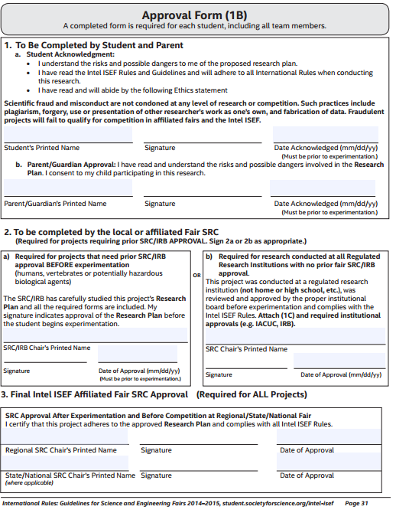
You are stating that you have read the rules.
DO NOT FILL THIS OUT. This is for the SRC to complete.

Slide 11
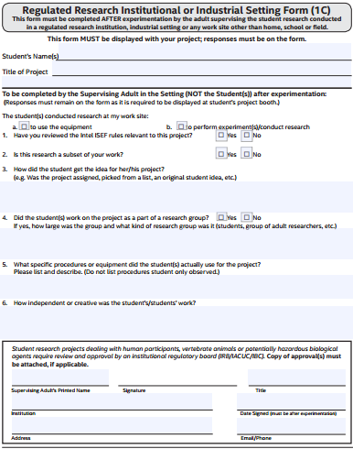
The Supervising Adult is to complete this form after the research is completed.
The Designated Supervisor is an adult who is directly responsible for overseeing student experimentation.
The Designated Supervisor need not have an advanced degree, but must be thoroughly familiar with the student’s project, and must be trained in the student’s area of research.
The Adult Sponsor may act as the Designated Supervisor.
If a student is experimenting with live vertebrates and the animals are in a situation where their behavior or habitat is influenced by humans, the Designated Supervisor must be knowledgeable about the humane care and handling of the animals.
The student’s name must be written clearly and be easy to read.
The project title must be the same on all forms and the
research plan.

Slide 12
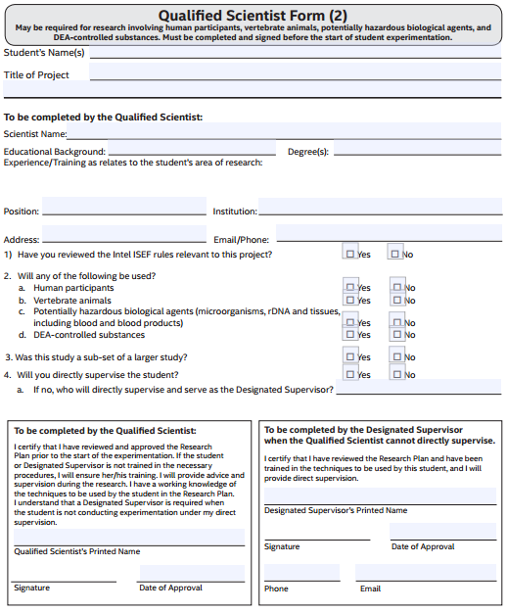
A Qualified Scientist is required for all studies involving BSL-2 potentially hazardous biological agents and DEA-controlled substances and for many human participant and many vertebrate animal studies.
A Qualified Scientist (QS) should have a doctoral/professional degree in a scientific discipline that relates to the student’s area of research.
A PhD, MD or a master’s degree with additional experience and expertise in the student’s area of research is acceptable when approved by a Scientific Review Committee (SRC).
The Qualified Scientist must be thoroughly familiar with local, state, and federal regulations that govern the student’s area of research.
The Qualified Scientist and the Adult Sponsor may be the same person, if that person is qualified as described above.
The student’s name must be written clearly and be easy to read.
The project title must be the same on all forms and the research plan.
How does the QS’s experience apply to this project?
The QS must review ISEF rules.
Name of the person listed in 4 , if applicable.
Must be before the start date on form 1B
Fill in ALL information and answer ALL questions.
Must be before the start date on form 1B
The QS must sign.

Slide 13
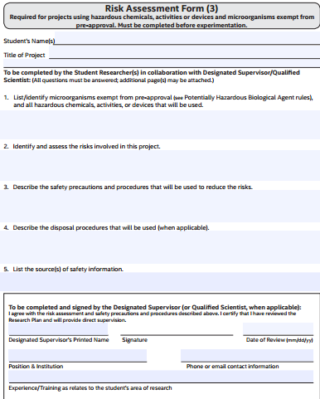
DO NOT SAY “See Research Plan”
The student’s name must be written clearly and be easy to read.
The project title must be the same on all forms and the research plan.
Fill in ALL information and answer ALL questions.
Identify ALL hazardous microorganisms, chemicals, activities and devices.
The Designated Supervisor is an adult who is directly responsible for overseeing student experimentation.
The Designated Supervisor need not have an advanced degree, but must be thoroughly familiar with the student’s project, and must be trained in the student’s area of research.
The Adult Sponsor may act as the Designated Supervisor.
Include risks to the student, participants, vertebrate animals as applicable. This should match the Research Plan.
MSDS, journal articles, package inserts, etc.
Must be before the start date on form 1B
Make sure this is completed
Make sure this is completed

Slide 14
Human participants
• Who? Are you looking for participants
in a specific age range, gender,
racial/ethnic composition)?
• What is the length of time involved
for each subject?
•Where will you find your participants?
• What will participants be asked to do?
• How will they be invited to participate?
• What are the risks or potential discomforts (physical, psychological, time involved, social, legal, etc..) to participants? How will you minimize the risks?
• Benefits (if any). List any benefits to the participant or to society. There may be no benefit to the participant for taking part in the research.
• Protection of Privacy. Will any identifiable information (e.g., names, telephone numbers, birth dates, email addresses) be collected? Will data be confidential or anonymous? If anonymous, describe how the data will be collected anonymously. If not anonymous, what procedures are in place for safeguarding confidentiality? Where will the data be stored? Who will have access to the data? What will you do with the data at the end of the study?
• Informed Consent. Research participants must voluntarily give informed consent/assent (in some cases with parental permission) before participating in the study.

Slide 15
Schools are responsible for creating a local IRB to review Human Subject research.
If a project involves humans and PHBA, Potential Hazardous Substances, Equipment or Procedures it must be reviewed by the SRC also.
Research, as defined by the code of federal regulations, 45 CFR 46, is a systematic investigation designed to develop or contribute to generalizable knowledge. School science fair projects are considered research and the students conducting the research are considered research investigators.
All schools participating in the Northeast Florida regional science and engineering fair must establish their own Institutional Review Board, IRB, to review human subject research projects.
Human subjects are individuals in which the investigator obtains data through intervention or interaction with the research subject or Identifiable private information.

Slide 16
The function of the school IRB is to ensure that the research projects are safe and ethical for subjects recruited to participate in research activities and safe for the students conducting the research by evaluating risks and the research design.
The student investigator must obtain IRB approval before engaging in any human subject research.
IRB membership must include:
an educator (not sponsor),
a school administrator
someone knowledgeable about evaluating physical and/or psychological risk: MD, PA, RN, psychologist, licensed social worker or licensed clinical professional counselor

Slide 17
Risk Assessment involves consideration of physical and psychological risks along with the protection of privacy.
The student researcher, adult sponsor and qualified scientist must develop procedures that reduce and minimize any risks to human subjects.
No more than minimal risk exists when the probability and magnitude of harm or discomfort anticipated in the research are not greater than those ordinarily encountered in daily life or during performance of routine physical or psychological examinations or tests. Studies must involve anonymous data to be considered no more than minimal risk.
More than minimal risk exists when the possibility of physical or psychological harm or harm related to breach of confidentiality or invasion of privacy is greater than what is typically encountered in everyday life The IRB will review the Research Plan and make the following determinations:
whether the study is approved or must be revised
whether the study contains no more than minimal risk or more than minimal risk to potential participants. The IRB will consider characteristics (e.g., age, health status, vulnerability to coercion) of the study population, the specific risks (e.g., physical, psychological, social, privacy) associated with the research activity and local norms when making a risk level determination;
whether documentation of informed consent/participant assent and/or parental permission are required or can be waived
whether a qualified scientist is required

Slide 18
Vulnerable Populations
When the subjects are children, prisoners, pregnant women, mentally disabled persons, or economically or educationally disadvantaged persons they are considered to be vulnerable and additional safeguards must be included in the study to protect the rights and welfare of these subjects.
Parents must give consent for children under 18 years old to participate.
Research conducted in schools must make sure that students are not pressured by teachers, administrators and/or peers.

Slide 19
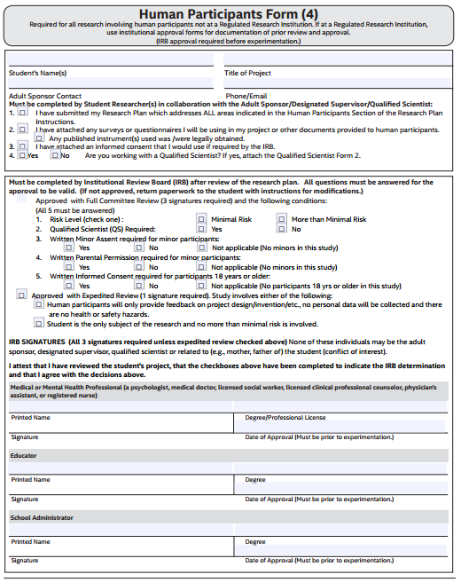
Check this box ONLY if you are using a “published” survey, questionnaire, or instrument (e.g. Myers-Briggs, etc..)
If you plan to obtain an actual copy of the instrument, you need to obtain permission to use the instrument. Research instruments may be copyrighted. To obtain permission, contact the copyright holder in writing (print or email).
This section is to be completed by the IRB. If not, the project may be DQ’d.
When the IRB reviews and approves the project.
it will choose Full Review and answer 1-5
(reviewed by a Health Professional, an Educator, and a School Administrator)
or Expedited Review
and check the appropriate box
(no personal data collected from subjects or no more than minimal risk and the student is the only subject)
Name clearly written The project title must match other forms
Sponsor listed on Form 1
More than minimal risk = risks greater than those encountered in everyday life
Full Review requires information and signatures from all three individuals.
Expedited review requires
information and signature of only the medical/mental health professional
The Adult Sponsor, parent or other relative of the student, the Qualified Scientist, and the Designated Supervisor who oversees the project may not serve on the IRB reviewing that project.
Signatures must be dated before the start date on Form 1B.

Slide 20
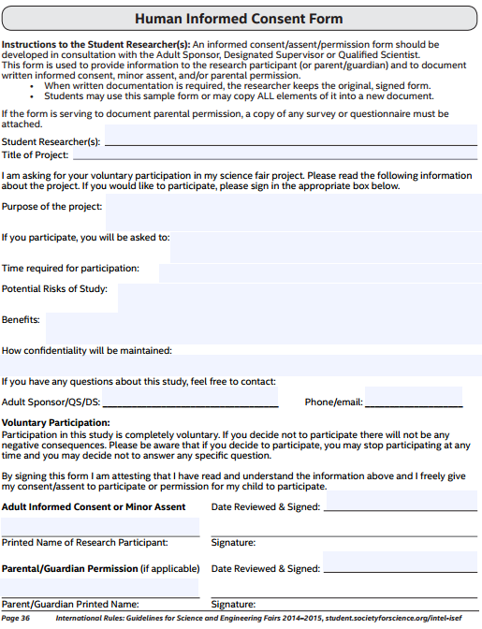
Written consent may be waived if
the student does not manipulate the behavior and there is no more than minimal risk
Surveys, questionnaires, etc. that do not gather personal info, invade privacy, or cause emotional distress
Risk is not greater than that encountered in daily life.
Physical, psychological, invasion of privacy and loss of confidentiality
There may be no benefit to the subject.
Online surveys require informed consent/assent.
-They may be set up with a check box.
-If parental permission is required signatures may be collected as electronic signature via email or through postal mail.

Slide 21
Informed Consents
Should be kept in a closed folder by the researcher.
Should be counted by the researcher to verify that the number of forms equals the number of data points.
The teacher will sign the Verification of Informed Consent and submit this with paperwork.
One original, signed consent should be copied, all identifiers blacked out, and copy submitted with paperwork.
Signed forms should be kept by the researcher for 3 years.

Slide 22
Vertebrates
Vertebrates are defined as:
Live, nonhuman mammalian embryos or fetuses
Tadpoles
Bird and reptile eggs within three days (72 hours) of hatching
All other nonhuman vertebrates (including fish) at hatching or birth.
Exception: zebra fish embryos until 7 days (168 hours) post- fertilization.
Eggs- you must know the date of fertilization to have it considered a non-vertebrate.
Fertilization date must be in the log book.
Don’t do anything to an egg that you wouldn’t do to a vertebrate!
Projects that cause more than momentary pain or distress are prohibited.

Slide 23
Vertebrate animals
Your Research Plan MUST include:
a. ALTERNATIVES to vertebrate animal use and present a detailed justification for use of vertebrate animals
b. potential impact or contribution this research may have
c. animal numbers, species, strain, sex, age, source, etc..
d. justification of the numbers planned for the research
e. how the animals will be housed and their daily care
f. how you will minimize potential discomfort, distress, pain and injury to the animals
g. chemical concentrations and drug dosages (if any)
h. what will happen to the animals at the end of the study – cannot release back into the environment
Studies involving behavioral observations of animals are exempt from prior SRC review if ALL of the following apply:
a. There is no interaction with the animals being observed,
b. There is no manipulation of the animal environment in anyway, and
c. The study meets all federal and state agriculture, fish, game and wildlife laws and regulations.
****let the SRC determine if a project is exempt*****
Must include multiple subjects.
A few subjects may not result in DQ, but it is not good science.

Slide 24
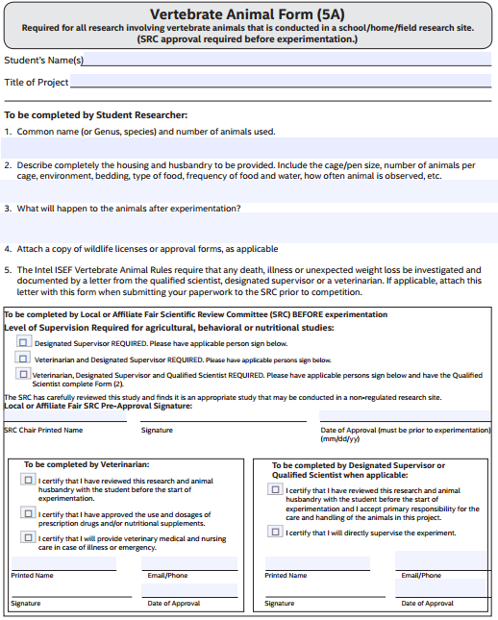
Animals must be housed in a clean, ventilated, comfortable environment appropriate for the species. They must be given a continuous, clean (uncontaminated) water and food supply. Cages, pens and fish tanks must be cleaned frequently. Proper care must be provided at all times, including weekends, holidays, and vacation periods. Animals must be observed daily to assess their health and well-being.
The student’s name must be written clearly and be easy to read.
The project title must be the same on all forms and the research plan.
Provide specific details.
No vertebrate animal deaths due to the experimental procedures are permitted in any group or subgroup. Such a project will fail to qualify for competition.
Must be approved before the start date on Form 1B.
A veterinarian must certify experiments that involve supplemental nutrition, administration of prescription drugs and/or activities that would not be ordinarily encountered in the animal’s daily life.
Must be approved before the start date on Form 1B.

Slide 25
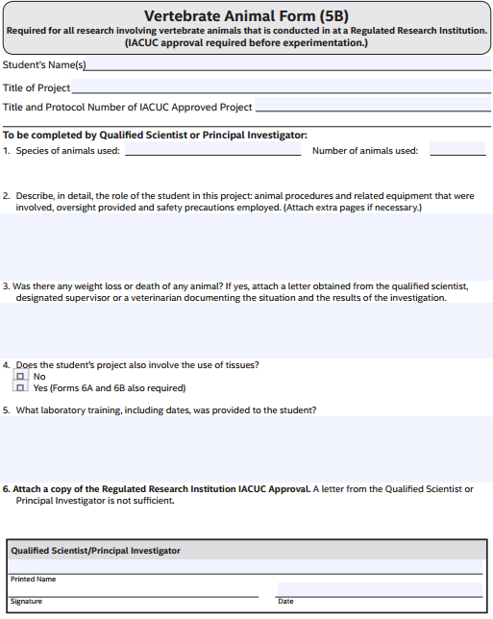
Institutional Animal Care and Use Committee (IACUC) approval is required for ALL projects involving animals in a Regulated Research Institution BEFORE the project begins.
The student’s name must be written clearly and be easy to read.
The project title must be the same on all forms and the research plan.
Required
ISEF Rules for which projects must be conducted at a Regulated Research Institution can be found at
https://member.societyforscience.org
Rules, pages 12-13
REQUIRED. The letter must show an approval date before the start date on Form 1B
The Qualified Scientist will sign this form when the project is completed.

Slide 26
Potentially hazardous biological agents
In your Research Plan describe Biosafety Level Assessment process and the BSL determination
• Give source of agent, source of specific cell line, etc..
• Detail safety precautions
• Discuss methods of disposal
Bibliography and Form 3 –
a. include the source of the organism
b. lab policies and procedures
c. Rules page 22, 1, 3, & 4.
Florida Sate SEF requires the BSL Safety Checklist
Experimentation involving the culturing of potentially hazardous biological agents, even BSL-1 organisms, is prohibited in a home environment. However, specimens may be collected at home as long as they are immediately transported to a laboratory with the BSL containment. Research determined to be at Biosafety Level 1 (BSL-1) must be conducted in a BSL-1 or higher laboratory.

Slide 27
Exempt from prior SRC review and require no additional forms:
a. Studies involving baker’s yeast and brewer’s yeast, except when used with rDNA studies.
b. Studies involving Lactobacillus, Bacillus thurgensis, nitrogen-fixing, oil-eating bacteria, and algae-eating bacteria introduced into their natural environment. (Not exempt if cultured in a petri dish environment.)
c. Studies involving water or soil not concentrated in media conducive to their growth (more specific c rules may apply).
d. Studies of mold growth on food items if the experiment is terminated at the first evidence of mold.
e. Studies of mushrooms and slime molds.
2. Exempt from prior SRC review, but require a Risk Assessment Form 3:
a. Studies involving protists, archaea and similar microorganisms.
b. Research using manure for composting, fuel production, or other non-culturing experiments.
c. Commercially-available color change coliform water test kits. These kits must remain sealed and must be properly
disposed. Studies involving decomposition of vertebrate organisms (such as in forensic projects).
e. Studies with microbial fuel cells.
Are you feeding, mixing, or opening? Consider these to determine BSL level.

Slide 28
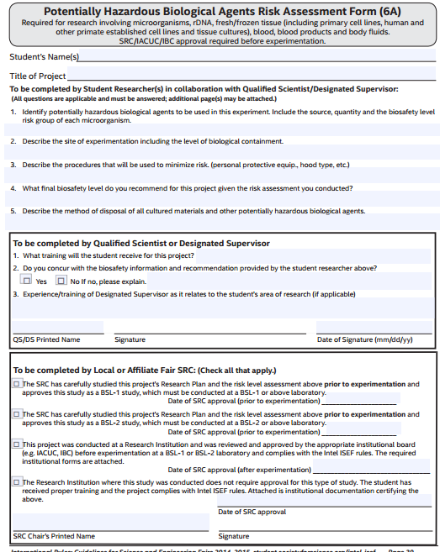
The Scientist or Supervisor should complete this form.
The Qualified Scientist must have at least a Master’s degree in the field or be a med tech in the lab.
Junior level – the QS may subculture, but the student may not be in the lab and the research plan must specifically stat who is doing what. Note on abstract.
DO NOT FILL THIS OUT. This is for the SRC to complete.

Slide 29
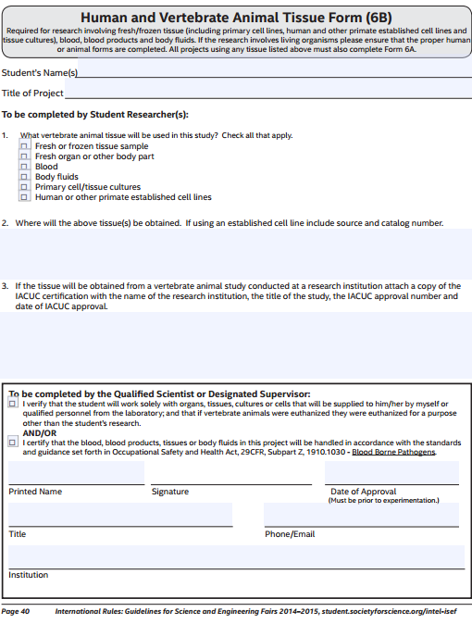
If students are using fish for a tissue sample, they may not use fish that they have caught.
Source and catalog number
Before date on 1B

Slide 30
Projects with hazardous chemicals, activities & devices must be reviewed by SRC
In your Research Plan describe Risk Assessment process and results
• Detail chemical concentrations and drug dosages
• Describe safety precautions and procedures to minimize risk
• Discuss methods of disposal
MSDS are now SDS and no longer have a numeric rating. Guidelines will be sent from State SEF.
Consider if the exposure is greater than minimal risk.
If the maximum power of a projectile is greater than that which can be thrown by a human arm (including paintballs, trebuchets, sling shots, air rifles, etc.) testing must be conducted at a range and supervised by a licensed range safety officer (a copy of credentials must be attached).
Research plan must be specific regarding safety.

